Slide 1
BUCKLING
IN REAL-LIFE
Vikas Anand 220104109
Divyansh Mishra
220104034
Bhargavi Divyam
220104024

Slide 2
Why does buckling even occur?
A perfectly symmetrical column can never fail through buckling but in the real world, there is nothing symmetrical.
Even the slightest asymmetry is enough to push the stable system away from its equilibrium.
This asymmetry will exist. Even if you could somehow ensure that the external shape of the column was perfectly symmetrical to atomic levels, there would be asymmetric defects - dislocations, voids, variations in composition, and so on.

Slide 3
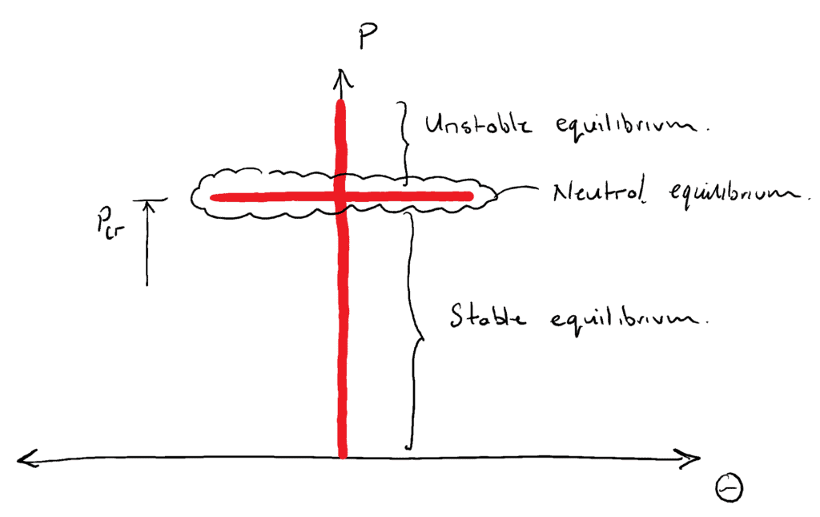
Why does buckling even occur?

Slide 4
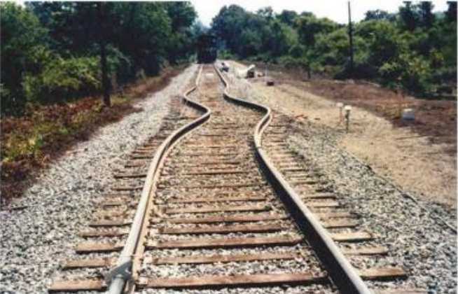

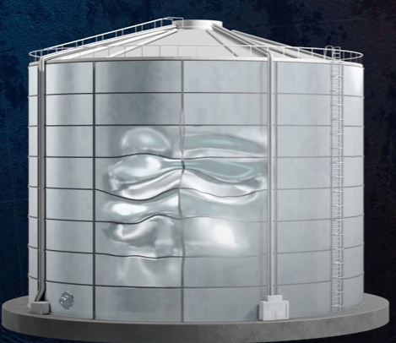
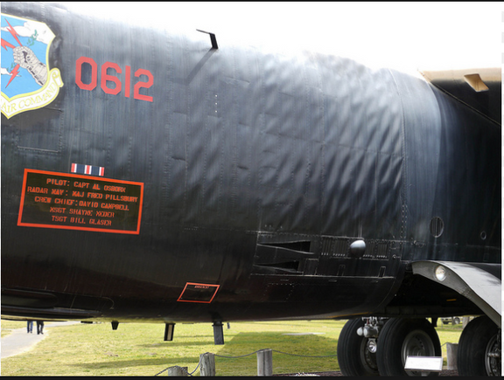
Real-Life Examples

Slide 5
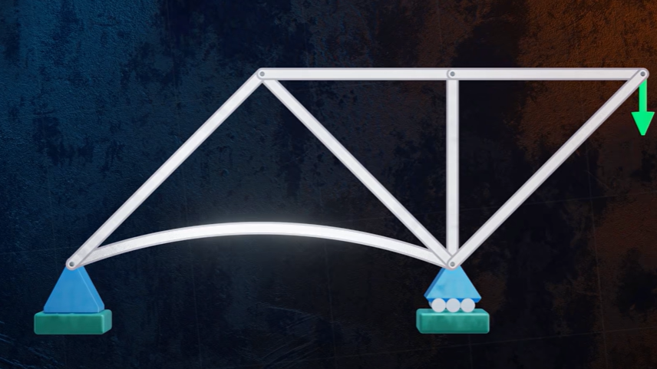
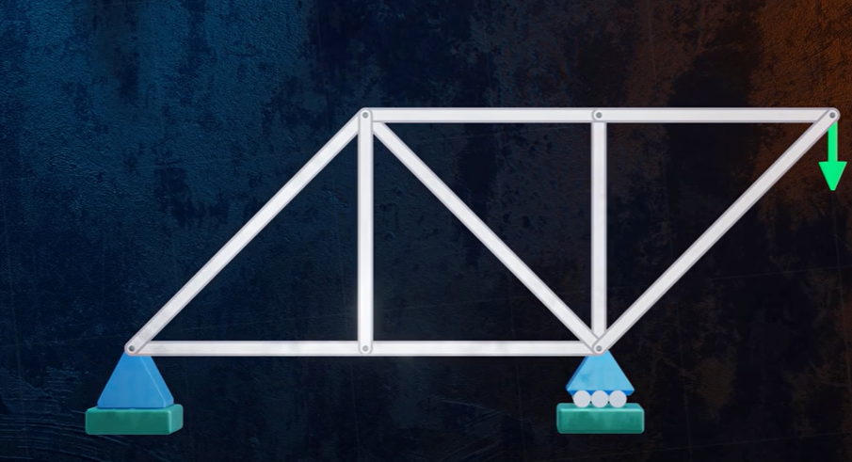
Real-Life Examples
This example shows the effect of buckling in a member of a simply supported truss, where compression in the lower member leads to buckling, this can be prevented by adding an extra member in the middle section.

Slide 6
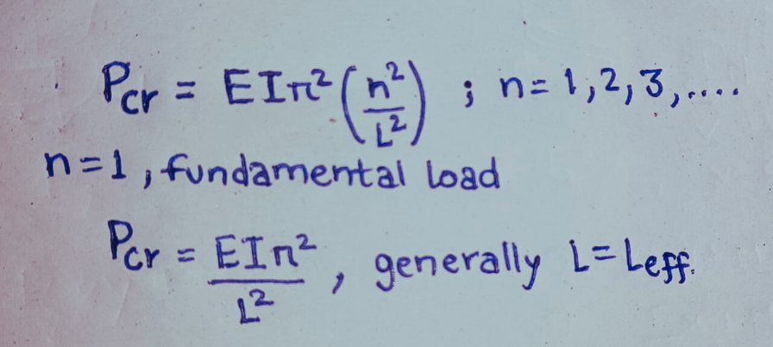
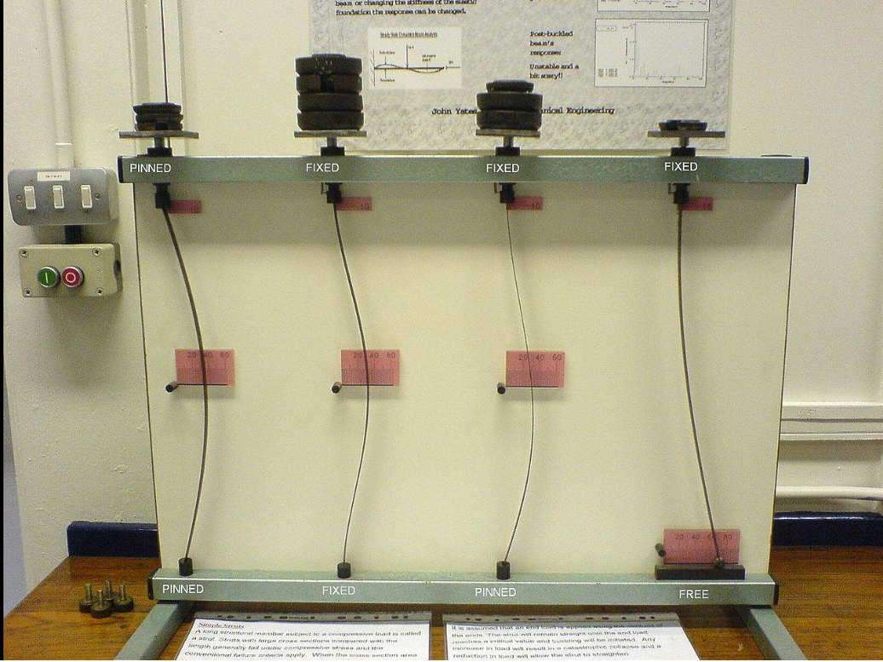
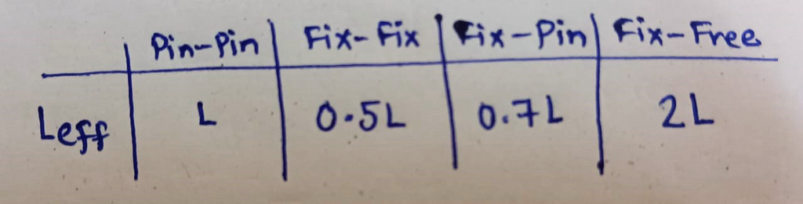
Critical Buckling Load
Euler Bernoulli equation:
EI y” = M
Pinned
Fixed
Fixed
Fixed
For different values of n we get different modes of buckling
Pinned
Fixed
Pinned
Free
Bar under different type of boundary conditions
Effective length for different conditions

Slide 7
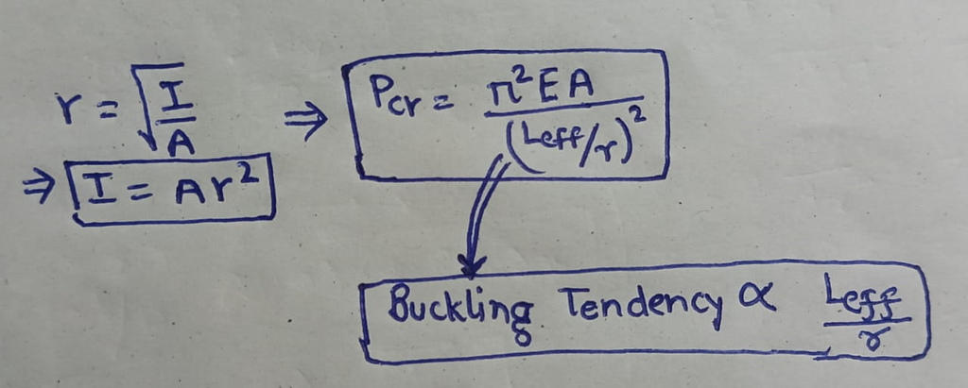
Slenderness ratio
The term slenderness ratio is the ratio of effective length to the radius of gyration of the column.
More Slender implies more Buckling

Slide 8
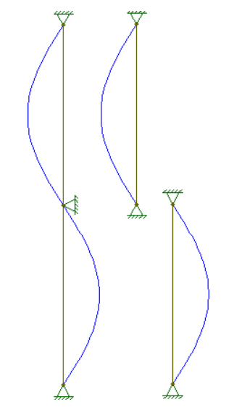
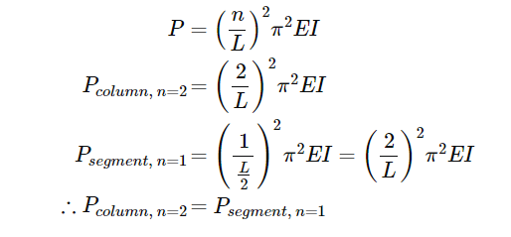
What are higher modes & how are they possible?
For a single column without any braces, it may not be possible but in real-world you may see long columns are often braced at regular intervals to reduce the unbraced length of the column
This is a braced column broken into 2 unbraced length
These buckling modes, however, are simply equivalent to the n=1�=1 modes of the individual segments that compose the column.

Slide 9
THANK YOU

